Slide 1
PSCS194-Patient Case Similarity
PIP2001 Capstone Project
Review-1
Batch Number: CSG – G15
Under the Supervision of,
Dr./Mr./Ms./Prof. Ankita Bhaumik
Professor / Associate Professor / Assistant Professor
School of Computer Science and Engineering
Presidency University
Roll Number | Student Name
20211CSG0047 20211CSG0064 20211CSG0040 20211CSG0036 | Shree Chakra J Tharun Kumar G Mohammed Affan M B Chandan R
Name of the Program: B.Tech
Name of the HoD: Dr. Saira Banu
Name of the Program Project Coordinator: Dr Manjula H M
Name of the School Project Coordinators: Dr. Sampath A K / Dr. Abdul Khadar A / Mr. Md Ziaur Rahman

Slide 2
Introduction
In the dynamic healthcare landscape, marked by rising patient numbers and escalating emergencies, the demand for robust solutions is paramount. Our proposed model, intricately designed for navigating complex challenges without immediate medical treatment, offers a beacon of hope with a prompt, individualized approach to care. At its core, the model identifies patients similar to a specified index patient by meticulously exploring past medical records. This groundbreaking method provides tailored forecasts, significantly elevating patient care quality, crucial in dire circumstances. Surpassing traditional methods, it meticulously examines health data, forecasting patients' future health statuses using advanced computer-based techniques. In emergencies, where quick medical treatment is limited, the model becomes indispensable, optimizing reactions by empowering healthcare practitioners with well-informed decisions based on comparable patient records. This model heralds a new era in patient-centric care, laying the foundation for transformative progress in predictive healthcare analytics, revolutionizing personalized, data-driven medical interventions.

Slide 3
Literature Review
The Patient Case Similarity project revolutionizes healthcare analytics, employing advanced data science for personalized and data-driven interventions. Utilizing sophisticated algorithms, it identifies patient case similarities, enhancing diagnostic accuracy, tailoring treatments, and improving outcomes.
This model is used to summarize and review system oriented approaches for identifying patient health condition based on their data as similarity status providing a starting point for further research.

Slide 4
Existing method Drawback
patient similarity
predictive modeling
health data
medical records
electronic health records
personalized medicine
data-driven prediction

Slide 5
Proposed Method
The method involved
(1) conducting the review by performing automated searches in Scopus, PubMed, and ISI Web of Science, selecting relevant studies by first screening titles and abstracts then analyzing full-texts, and
(2) documenting by extracting publication details and information on context, predictors, missing data, modeling algorithm, outcome, and evaluation methods into a matrix table, synthesizing data, and reporting results.

Slide 6
Objectives
The aim is to summarize and review published studies describing computer-based approaches for predicting patients’ future health status based on health data and patient similarity, identify gaps, and provide a starting point for related future research.

Slide 7
Methodology/Modules
Data Acquisition and Preprocessing
Machine Learning Model Development
Natural Language Processing for Symptom Analysis
Development of the Flask Web Application
Validation and Testing

Slide 8
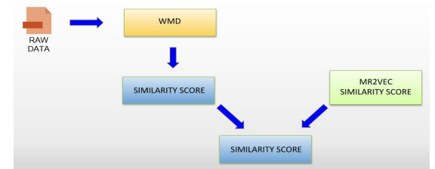
Architecture

Slide 9
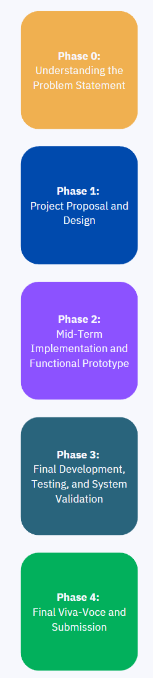
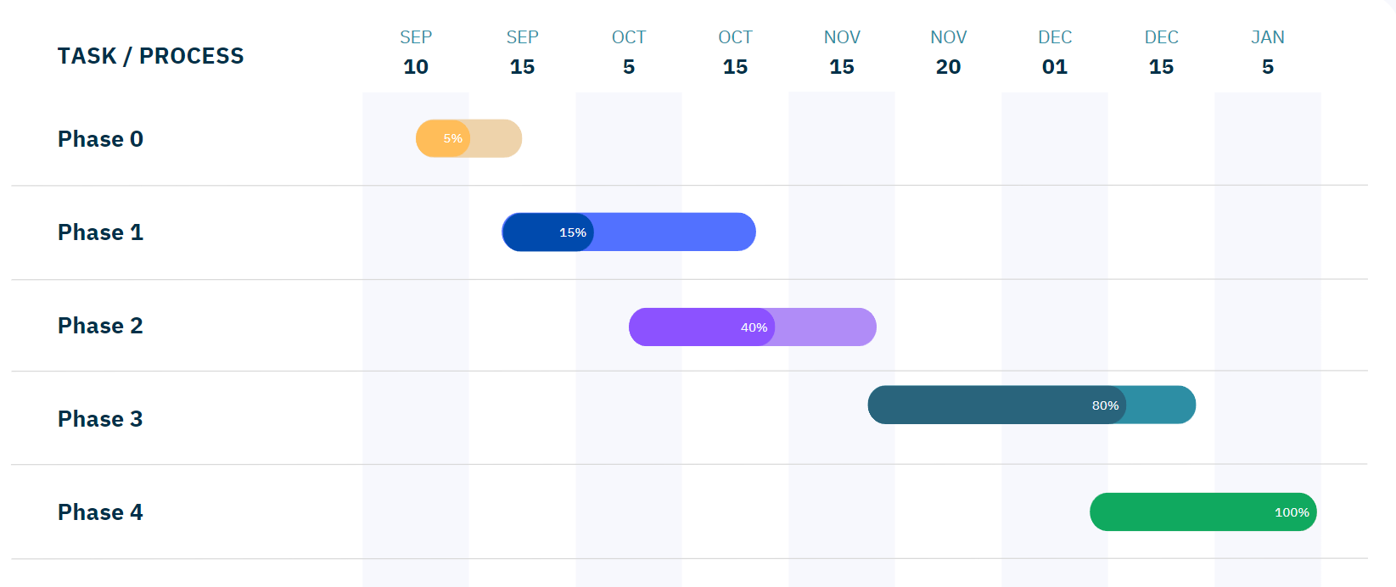
Timeline of Project

Slide 10
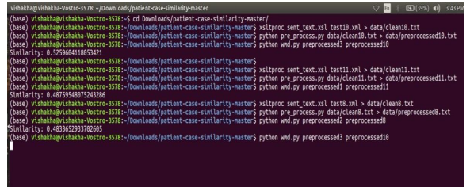
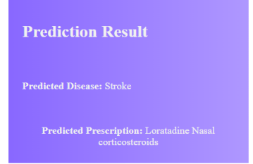
Expected Outcomes

Slide 11
Conclusion
The healthcare analytics breakthrough, particularly in predictive patient case similarity, addresses industry challenges with an intricately designed system. Fueled by advanced machine learning, it responds to escalating patient numbers and emergency risks. The system's core innovation lies in state-of-the-art algorithms, emphasizing data preprocessing for reliable input. This meticulous approach enhances model precision, enabling more accurate predictions. Its seamless integration into hospital systems ensures efficiency in managing extensive patient data, making it a valuable asset for healthcare operations. The system's patient centric care, ethical considerations, and adaptability contribute to transformative healthcare analytics, promising accurate predictions, personalized treatments, and improved outcomes.

Slide 12
Github Link
The Github link provided should have public access permission.
GitHub Link : https://github.com/CHANDAN1214

Slide 13
References
[1] Anis Sharafoddini, Joel A Dubin and Joon Lee, “Patient Similarity in Prediction Models Based on Health Data”, JMIR Med Inform 2017 Jan-Mar, 5(1): e7.
[2] LWC Chan, T Chan, LF Cheng, WS Mak, “Machine Learning of Patient Similarity”, Bioinformatics and Biomedicines Workshops, 2010 IEEE International Conference. Gyusoo Kim and Seulgi Lee, “2014 Payment Research”, Bank of Korea, Vol. 2015, No. 1, Jan. 2015.
[3] Sharafoddini, A.; Dubin, J.; Lee, J. Patient Similarity in Prediction Models Based on Health Data: A Scoping Review. JMIR Med. Inform. 2017, 5, e7.
More……..

Slide 14

Project work mapping with SDG

Slide 15
Thank You

